Slide 1

Lackawanna/Luzerne MPO
April 17, 2019
Coordinating Committee

Slide 2
LeT
PROJECTS
April – June 2019

Slide 3

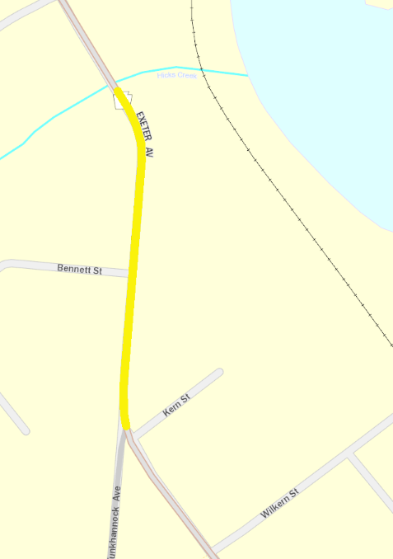
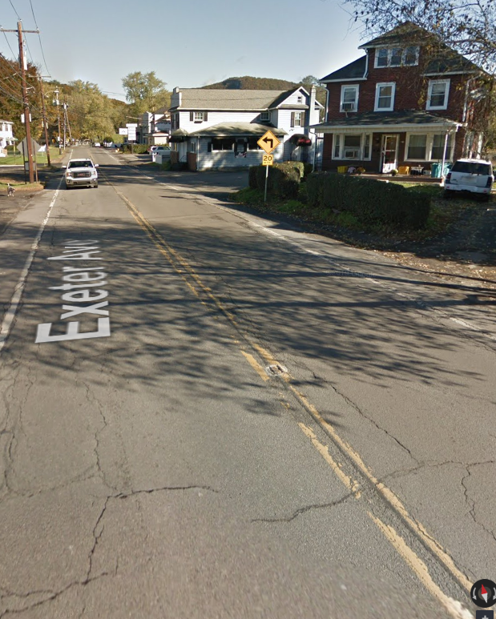
Let Projects APR – JUN 2019:
Project ID: 112811
Project Title: SR 92 Emergency Roadway Depression
County: Luzerne
Municipality: Exeter Borough
Route: SR 92 from Kern Street to past Bennett Street
Improvement Type: Highway Restoration
Let Date: 3.29.2019
Emergency roadway repair on State Route 92 (Exeter Avenue) from Kern Street to past Bennett Street, Exeter Borough, Luzerne County.

Slide 4
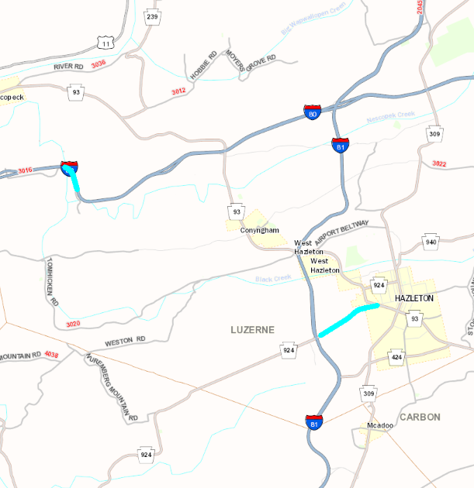
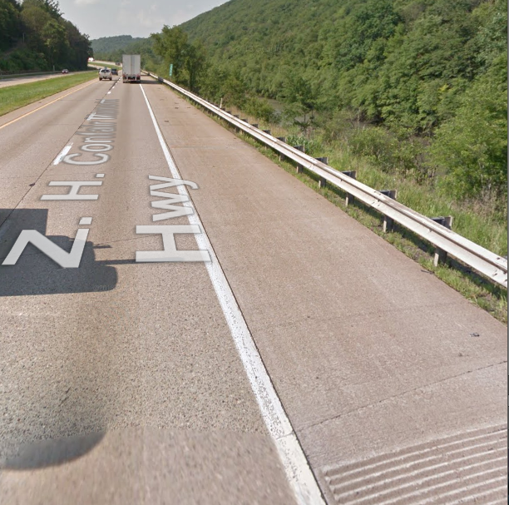
Let Projects APR - JUN 2019:
Project ID: 111043
Project Title: SR 924 / I-80 Cable Median Barrier
County: Luzerne
Municipality: Hazleton City & Hazle, Black Creek, & Nescopeck Townships
Route: State Route 924 & I-80
Improvement Type: Guiderail Maintenance
Let Date: 5.9.2019
Median Barrier installation on State Route 924 and on State Route 80 in Hazleton City, and Hazle, Black Creek and Nescopeck Townships, Luzerne County.

Slide 5
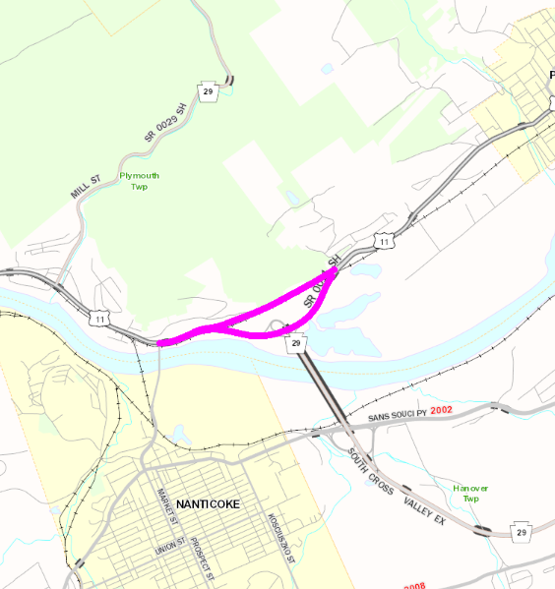
Let Projects APR – JUN 2019:
Project ID: 102556
Project Title: SR 11 Federal Paving
County: Luzerne
Municipality: Plymouth, Edwardsville, Kingston, & Forty Fort
Route: State Route 11
Improvement Type: Resurfacing
Let Date: 5.23.2019
Resurfacing on State Route 11 from Lower Broadway Street to High Road and from Lower Road to Church Street, in Plymouth Township and Edwardsville, Kingston, and Forty Fort Boroughs, Luzerne County

Slide 6
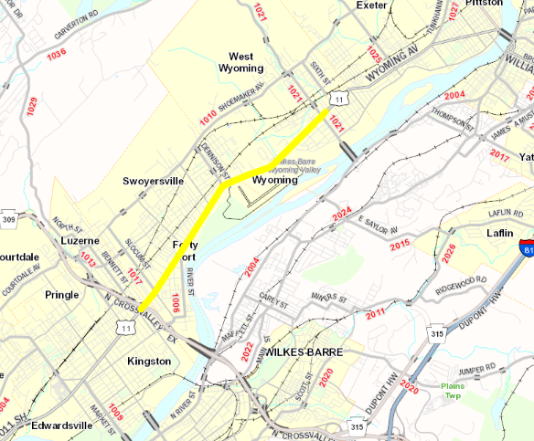
Let Projects APR – JUN 2019:
Project ID: 112465
Project Title: SR 11 Federal Curb Ramps
County: Luzerne
Municipality: Forty Fort, Kingston, & Wyoming Boroughs
Route: State Route 11
Improvement Type: ADA Curb Cuts
Let Date: 5.23.2019
Curb ramp installation on State Route 11 from Breese Street to Church Street in Forty Fort, Kingston, and Wyoming Boroughs, Luzerne County.

Slide 7
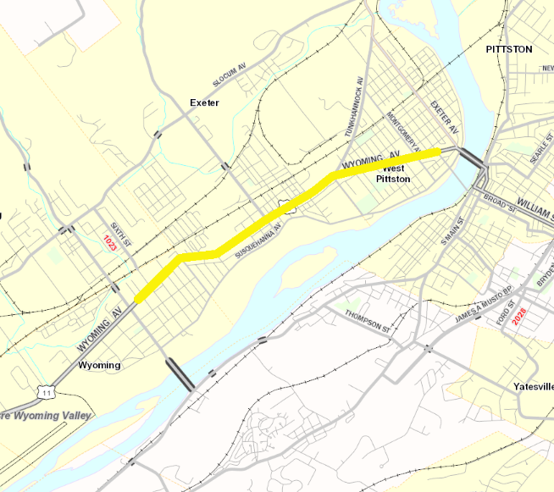
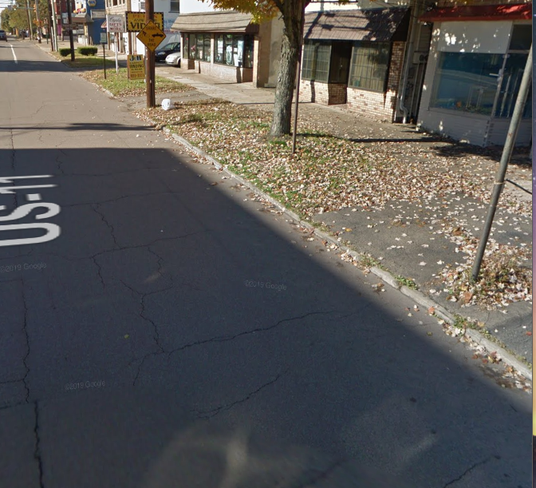
Let Projects APR – JUN 2019:
Project ID: 112466
Project Title: SR 11 Federal Curb Ramps
County: Luzerne
Municipality: Wyoming, Exeter, & West Pittston Boroughs
Route: State Route 11
Improvement Type: ADA Curb Cuts
Let Date: 5.23.2019
Curb ramp installation on State Route 11 from Breese Street to Luzerne Avenue in Wyoming, Exeter, and West Pittston Boroughs, Luzerne County.

Slide 8
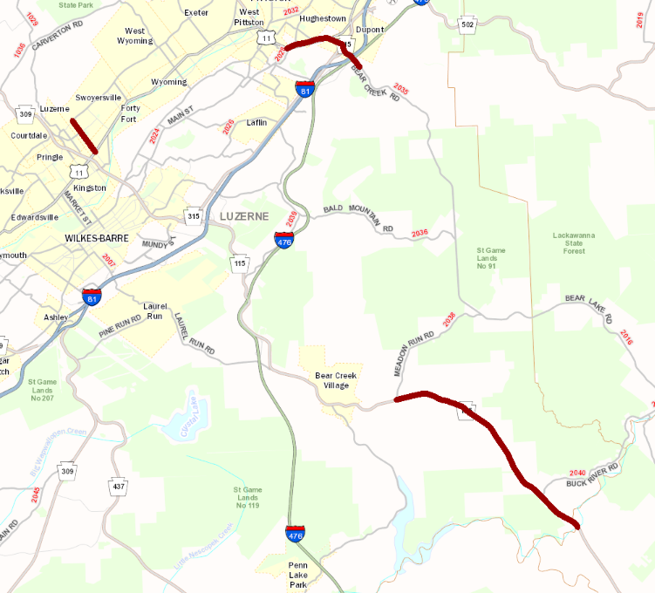
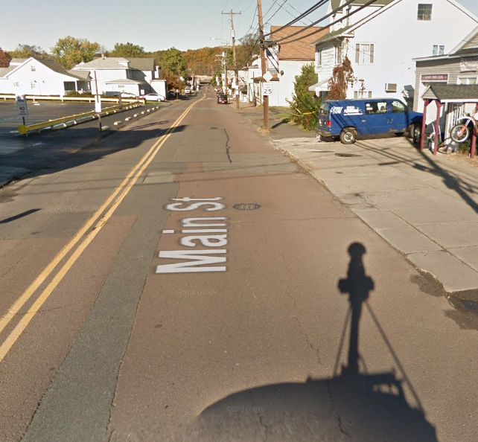
Let Projects APR – JUN 2019:
Project ID: 102558
Project Title: Fed Aid Paving 4-19-FP1 SR 115, 1017, & 2035
County: Luzerne
Municipality: Buck, Bear Creek, Pittston Township, Forty Fort,
Swoyersville, & Dupont
Route: 115, 1017, & 2025
Improvement Type: Resurfacing
Let Date: 6.6.2019
Federal Aid Paving on SRs 115 (Buck/Bear Creek Boulevard), 1017 (Slocum St), and 2035 (Bear Creek Rd/Main St) in Buck, Bear Creek and Pittston Townships, Forty Fort, Swoyersville, and Dupont Boroughs, and Pittston City, Luzerne County.

Slide 9
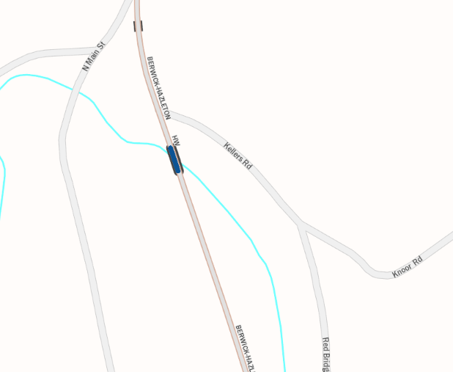
Let Projects APR – JUN 2019:
Project ID: 9079
Project Title: SR 93 over Nescopeck Creek
County: Luzerne
Municipality: Sugarloaf Township
Route: State Route 93
Improvement Type: Bridge Replacement
Let Date: 6.20.2019
Bridge replacement on State Route 93 (Berwick-Hazelton Highway) over Nescopeck Creek in Sugarloaf Township, Luzerne County.

Slide 10
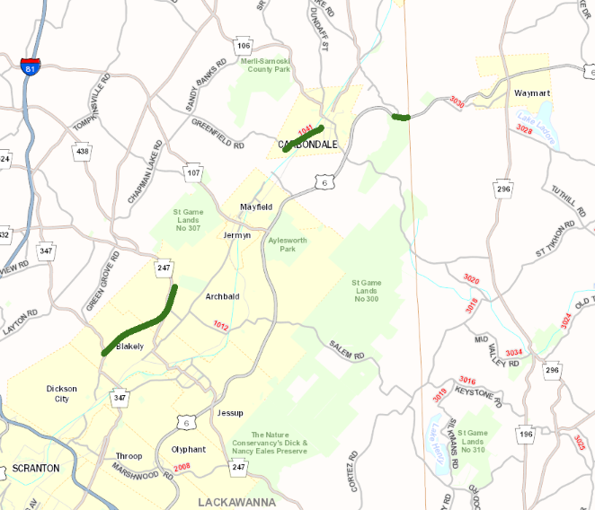
Let Projects APR - JUN 2019:
Project ID: 102557
Project Title: Fed Aid Paving 4-19-FP1 SR 6006, 6 & 1041
County: Lackawanna
Municipality: Scott, Carbondale, & South Abington Townships &
Blakely, Dickson City, & Archbald Boroughs
Route: SR 6, 1041, 6006
Improvement Type: Resurfacing
Let Date: 6.6.2019
FedAid Paving on SR 6 (Robert P Casey Highway) 1041 (Cottage/Pike Street) and 6006 (Scranton-Carbondale Highway), in Scott, Carbondale and South Abington Townships and Blakely, Dickson City and Archbald Boroughs

Slide 11
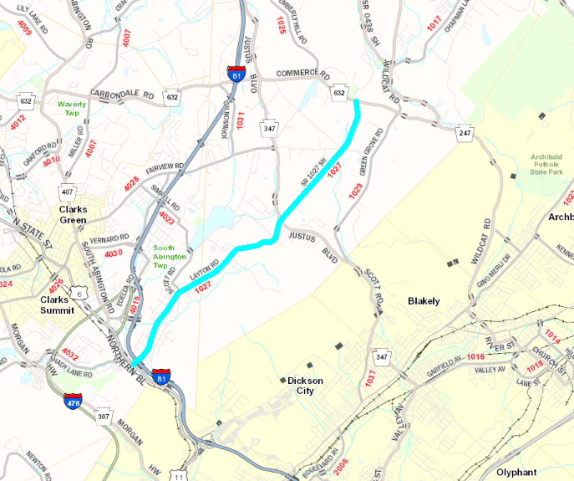
Let Projects APR - JUN 2019:
Project ID: 102899
Project Title: Lackawanna SR 1027 Paving
County: Lackawanna
Municipality: South Abington & Scott Townships
Route: 1027
Improvement Type: Resurfacing
Let Date: 6.6.2019
Resurfacing on State Route 1027 (Layton Road) from State Route 11 (Northern Boulevard) to State Route 632 (Commerce Road), South Abington, Scott Townships, Lackawanna County.

