Slide 1
District 4-0 LLTS HSIP Plan

Slide 2
District 4-0 LLTS HSIP Plan
High Friction Surface Treatment

Slide 3
District 4-0 LLTS HSIP Plan
High Friction Surface Treatment Project:
MPMS# 112763 / S.R. 0006 Sec. HFS / S.R. 6 High Friction Surface
Description of work: Placement of epoxy embedded with a hardened stone (Bauxite) on the roadway surface. Installation of chevron signing as needed and line painting.
Purpose: To increase the skid resistance of pavements to allow vehicles to remain in the travel lane and reduce braking distance. Increase delineation with signs.
Need: To reduce crashes at locations with above average crash rates located on the MPO Network Screening List, High Crash Location List or Crash Cluster Lists.
Costs: Preliminary Engineering: $10,000 Construction: $1,400,000
LET Date: 7/25/2019 Completion: 12/31/2019

Slide 4
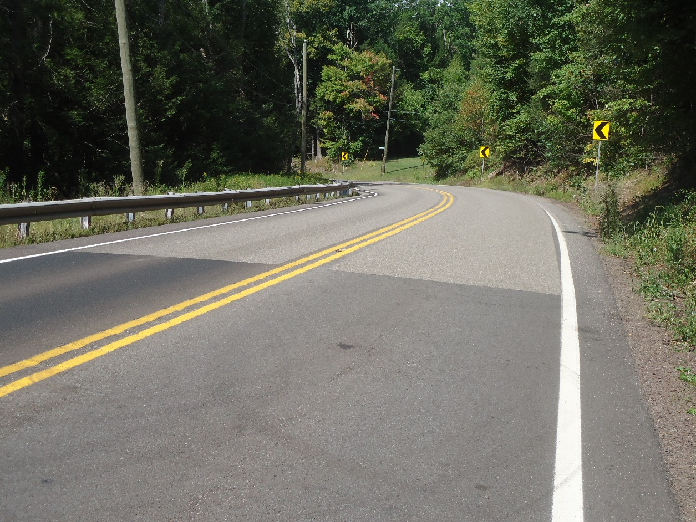
District 4-0 LLTS HSIP Plan
Luzerne Co. Jackson Twp. S.R. 0029 existing High Friction Surface Treatment.

Slide 5
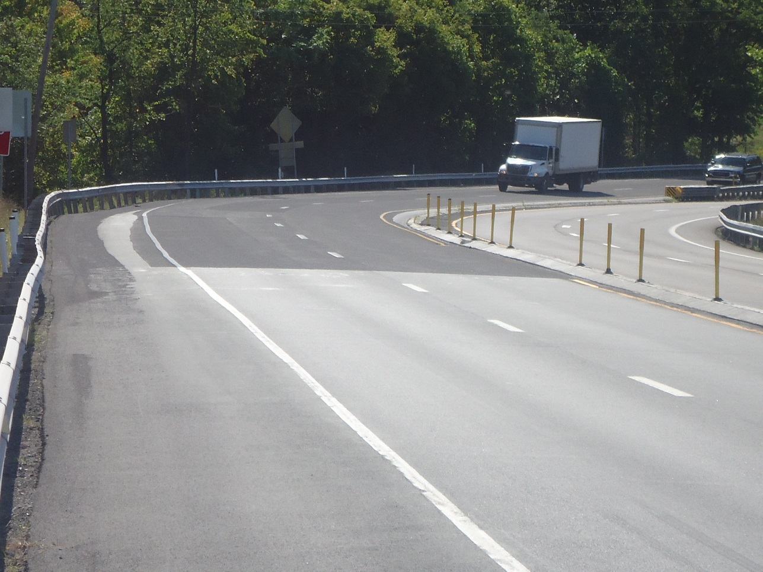
District 4-0 LLTS HSIP Plan
Luzerne Co. Hanover Twp. S.R. 0309 NB existing High Friction Surface Treatment.

Slide 6
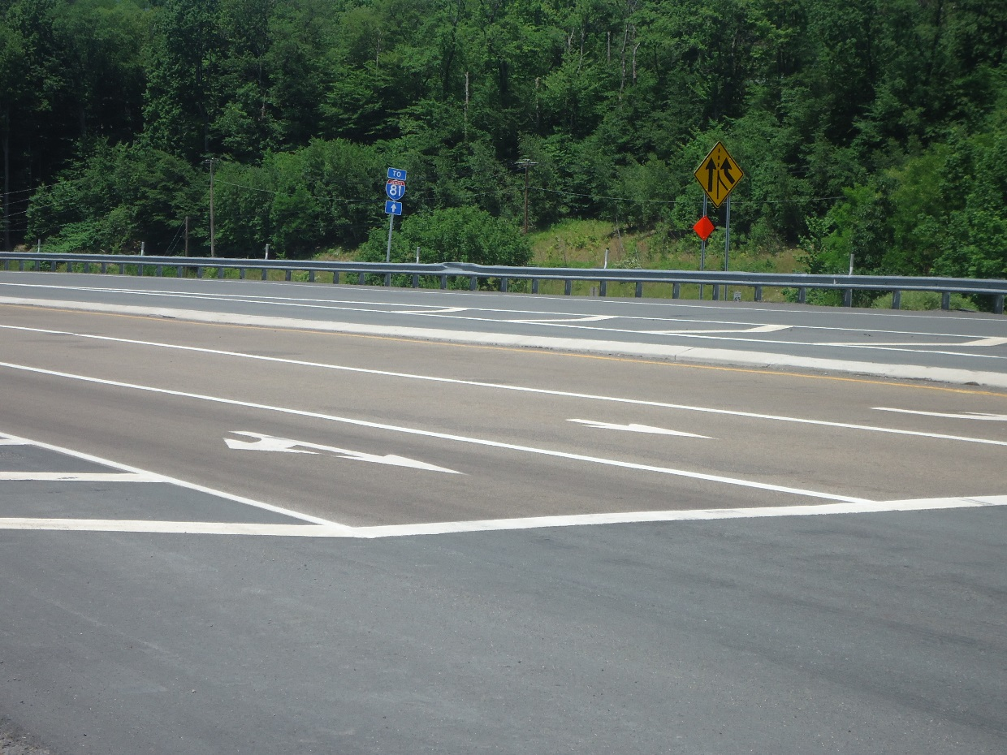
District 4-0 LLTS HSIP Plan
Lackawanna Co. Carbondale Twp. S.R. 0006 existing High Friction Surface Treatment.

Slide 7
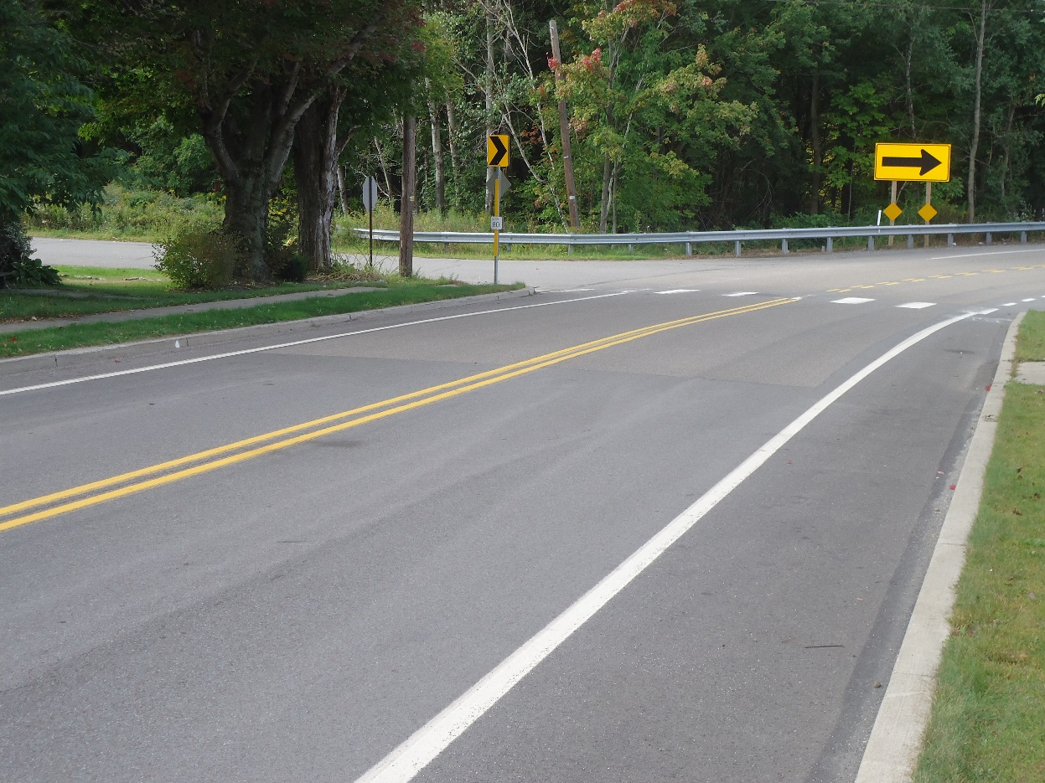
District 4-0 LLTS HSIP Plan
Lackawanna Co. Vandling Borough S.R. 0171 existing High Friction Surface Treatment.

Slide 8
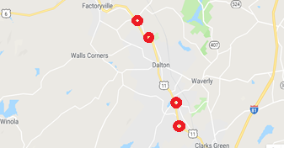
District 4-0 LLTS HSIP Plan
Lackawanna Co. S.R. 0006 proposed locations.

Slide 9
District 4-0 LLTS HSIP Plan
Lackawanna Co. S.R. 0106 proposed location.

Slide 10
District 4-0 LLTS HSIP Plan
Lackawanna Co. S.R. 2008 proposed location.

Slide 11
District 4-0 LLTS HSIP Plan
Luzerne Co. S.R. 0309 proposed location.

Slide 12
District 4-0 LLTS HSIP Plan
Luzerne Co. S.R. 0115 proposed locations.

Slide 13
District 4-0 LLTS HSIP Plan
Luzerne Co. S.R. 2024 proposed location.

Slide 14
District 4-0 LLTS HSIP Plan
Questions ???

